Slide 1
Adult Income
What determines whether an adult will have a high income versus a low income?

Slide 2
About the Dataset
15 columns, 48842 rows
9 columns contain categorical data
6 columns contain numeric data
Covers adults from ages 17-90
Target variable is income
Income is separated into two categories: <=50K and >50K

Slide 3
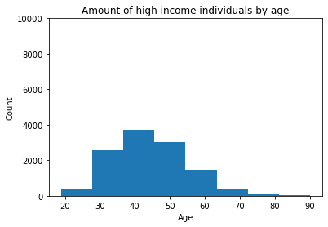
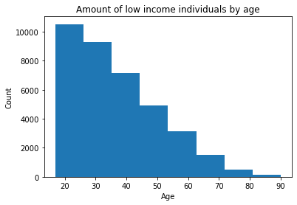
What impact does age have on an individual’s income?
It is clear that the older an individual is, the more likely they are to be high income. However, every age bracket has more low income individuals than high income individuals.

Slide 4
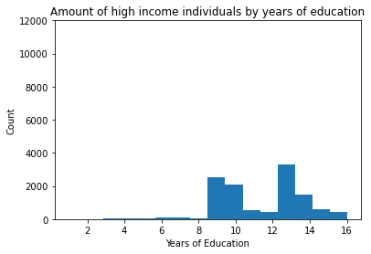
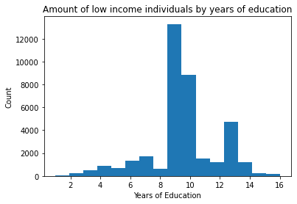
What impact does education have on income?
We can see that individuals with 13 or more years of education have a much greater chance of being high income earners than individuals with fewer than 13 years of education. Individuals with 15-16 years of education tend to be high income earners.

Slide 5
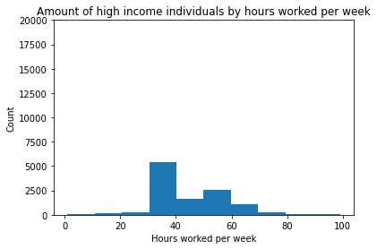
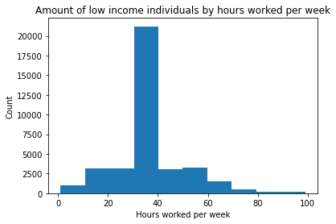
What impact does weekly hours worked have on income?
Individuals who work fewer than 40 hours a week are extremely unlikely to be high income earners. Individuals who work 60+ hours a week are roughly as likely to be high income as they are to be low income earners.

Slide 6
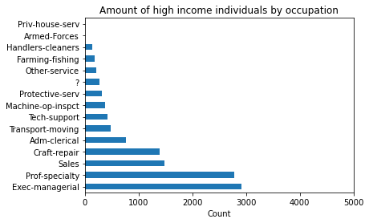
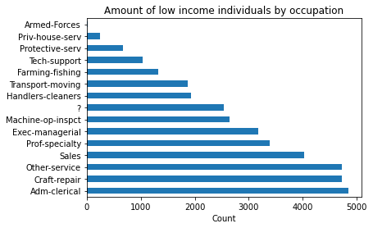
What impact does type of occupation have on income?
Occupation can have a major impact on whether an individual has a high income. For example, Exec-managerial and Prof-speciality tend to have higher incomes than Adm-clerical and Craft-repair.

Slide 7
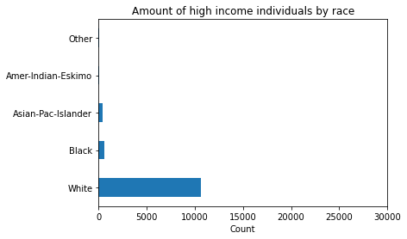
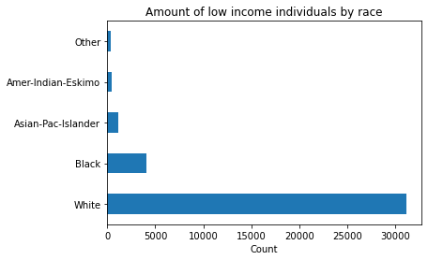
What impact does race have on income?
Whites and Asian-Pac-Islanders are more likely to be high income than Blacks and Amer-Indian-Eskimos. However, regardless of their race, an individual is still at least three times as likely to be low income than high income.

Slide 8
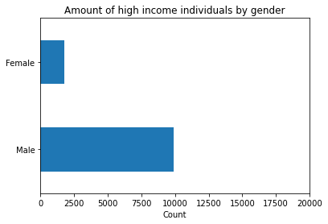
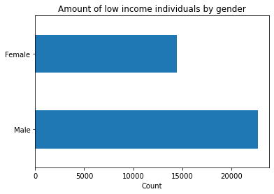
What impact does gender have on income?
Males are substantially more likely than females to have high incomes. The low income-high income ratio is ~2.5:1 for men and ~6:1 for women.

Slide 9
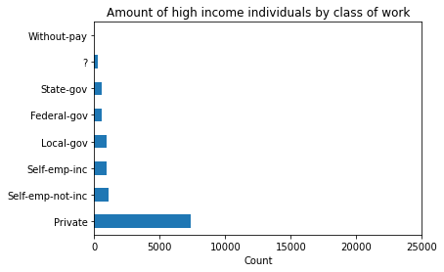
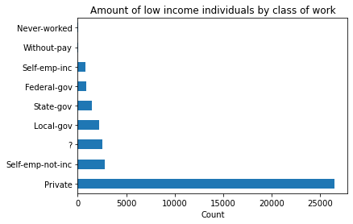
What impact does class of work have on income?
Individuals that are Self-emp-inc were more likely to be high income than low income. Everyone else was at least twice as likely to be low income than high income.

